Slide 1
Data Structures
Ms. Swati Mali
swatimali@somaiya.edu

Slide 2



What do I teach?
Data structures
Analysis of Algorithms
System Security
Artificial Intelligence
Operating systems
Computer Networks
Social, mobile, analytics and Cloud

Slide 3
What for you could contact me?
Coordinator, Higher studies
Faculty In-charge, SMLRA
Member, Digital media team
Member, Project competition Cell

Slide 4
What all data do we process?
Huge lists?
Spotify/gaana song collections
Railways
E-commerce platform products
Water supply
Admission applications
Stadium management – multiple entries and exits
Sentiment analysis of twitter data
GIS data and analysis
Google search
Search for files in local systems
Social networks, insights and analysis
User applications

Slide 5
Data structures: What and Why?
Data structure is a particular way of storing and organizing information in a computer so that it can be retrieved and used most productively.
Different kinds of data structures are meant for different kinds of applications, and some are highly specialized to specific tasks.
Where might we need data structures?

Slide 6
Why Data structures?
To process data in volatile/temporary memory
For design of efficient algorithms.
Program = Algorithm + Data structure
Data use and easier data processing on a software system.

Slide 7
Data structures Vs Database Vs knowledgebase!!

Slide 8
Which Data structures?
Stack - LIFO
Queue- FIFO, Queue, Circular queue, Dequeue, Priority queue
Linked lists- singly linked list, doubly linked list, circular linked list
Graph
Trees – General trees, binary trees, binary search trees, B tree, B+ tree, heaps, AVL trees
Set, map, dictionary

Slide 9
Data structures in real life?
A Queue for bus
Waiting in clinic or office
Maps, geographical or railway maps etc
Social networks
Undo operation in any s/w or app
Operating system processes
Evaluate an equation
Games like chess, tic-tac-toe
Family history

Slide 10


Course outcomes
CO1 | Explain the different data structures used in problem solving
CO2 | Apply linear and non-linear data structure in application development.
CO3 | Describe concepts of advance data structures like set, map & dictionary
CO4 | Demonstrate sorting and searching methods.

Slide 11
Course Outcome
CO | CO Description
CO 1 | Comprehend the different data structures used in problem solving
CO 2 | Apply linear and non-linear data structure in application development.
CO 3 | Describe concepts of advanced data structures like set, map & dictionary.
CO 4 | Demonstrate sorting and searching methods.

Slide 12
Books
1 | Ellis Horowitz, Sartaj Sahni, Susan Anderson-Freed | Fundamentals Of Data Structures In C
2 | Richard F. Gilberg & Behrouz A. Forouzan | Data Structures :A Pseudocode Approach with C
3 | Jean Paul Tremblay, Paul G. Sorenson | An introduction to data structures with Applications
4 | Aaron M Tanenbaum ,Yedidyah Langsam, Moshe J Augentstein | Data structure Using C
5 | Michael T Goodrich Roberto Tamassia, David Mount | Data Structure and Algorithm in C++

Slide 13
Lab Work
Sr. No | Topic
1 | Implementation of ADT without using any standard library function
2 | Static Implementation of Stack- Basic operations (Creation, Insertion, Deletion, Peek)
3 | Introduction to Dynamic Memory Allocation. DMA functions malloc(), calloc(), free() etc. Implementation of Basic Linked List -Creation, Insertion, Deletion, Traversal, Searching an element.
4 | Implementation of Dynamic implementation of Stack- Creation, Insertion, Deletion, Peek)
5 | Implementation of Queue operations (Static and Dynamic implementation)
6 | Implementation of various types of LL- doubly LL, circular LL, circular doubly LL etc
7 | Implementation of Binary Search Tree- insertion, search and traversal
8 | Study of Graph traversal methods
9 | Implement a dictionary for some real world application. Perform operations like union, intersection, and difference. Use C/C++ or python.
10 | Hashing - Linear and quadratic hashing
11 | Implementation of sorting Algorithms.

Slide 14
Lab assessment Rubrics
Attendance | Timely execution of code and submission of write-up | Quality of the code (Correct program with comments and output) | Originality of code | Understanding of concepts | Quality and originality of write-up, including the post lab questions | LAB Total | On-screen test | Total
5 | 5 | 5 | 5 | 5 | 5 | 30 | 20 | 50

Slide 15
Programming language
C language
Why???

Slide 16
Internal Assessments
Sr. No. | Task | Description of task | Schedule
1 | Rapid Fire activity with flash cards | Every student has to prepare 10 flash cards on data structures in module 1, 2 and 3.1 | After ISE
2 | Peer grading Programming assignment using a data structure to develop solution for a small application | This can be done in a group of 3-4 students. Small programming programs will be assigned to each group. The presentation screencast video should- explain the problem statement, logic, code and output. The video duration will be max 10mins All students must participate in presentation Students would choose a problem statement and suggest one of the data structure for developing the solution, and how the solution will be implemented. Upon teacher’s approval, students would work on the chosen problem and submit their work. Code submission will be on Turnitin platform to check plagiarism and originality. Deliverables: code, Turnitin Report of code, Screencast Video | First Week of Oct

Slide 17
Test
Module 1.2 and 3.1
Module 1- Introduction , Types of Data Structures, ADT (Abstract data type)
Module 2 - Linear data structure (linked list, stack and queue)
Module 3.1 – Nonlinear data structure (Tree)

Slide 18
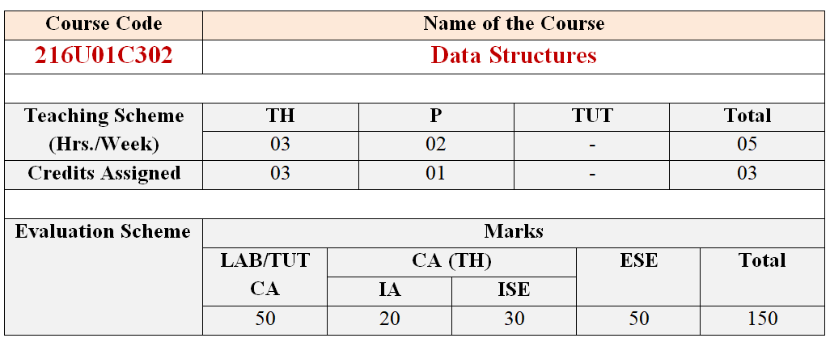
Evaluation Scheme
Number of credits – 04 (TH – 03 , PR – 01)
Term Test/ISE – 30 marks
Internal Assessment – 20 marks
End Sem. Exam – 100 converted to 50 marks
Lab CA – 50 marks

Slide 19
Modes of Content Delivery
Blackboard Teaching
Visual Aids- simulations
NPTEL Video Lectures
Guest Lecture
Test
Assignments

Slide 20
Data structures Implementation

Slide 21
Variables, arrays and Pointers
Variable
Pointer variable
Memory allocation
Array allocations
Dynamic memory allocation

Slide 22
Memory
Memory – Main memory, Secondary memory
How do you differentiate : RAM, main memory, Primary memory, secondary memory, HDD???
Main memory and program execution
Can a user have access to entire main memory space?
Can a program be larger than main memory?

Slide 23
How Memory are allocated?
Contiguous memory allocation
Memory is allocated in a single continuous block
Often used for arrays and other fixed-size data structures
Non-contiguous memory allocation
Memory is allocated in multiple separate blocks.
Used in linked lists, hash tables, and other dynamic data structures.

Slide 24
How Memory are allocated?
Static memory allocation
Memory is allocated at compile time and remains fixed throughout the program's execution.
Dynamic memory allocation
Memory is allocated at runtime as needed.

Slide 25
Static vs Dynamic memory allocation
 | Static memory allocation | Dynamic memory allocation
Definition: | Memory is allocated at compile time. | Memory is allocated at runtime.
Characteristic: | The size of the memory allocated is fixed and cannot be changed during runtime. | The size of the memory allocated can change as needed during execution.
Predictability: | Memory usage is known ahead of time. | Memorry requirements not known beforehand
Performance: | No runtime overhead for allocation and deallocation. | Runtime overheand for allocation and deallocation of memory; Risk of memory leaks, fragmentation, and dangling pointers
Ease of use | Easy to implement and manage as the memory layout is fixed. | Managing dynamic memory is more complex and error-prone.
Flexibility | Memory size cannot be changed after allocation. | Can allocate and deallocate memory as required.
Efficient memory usage | May lead to inefficient memory usage if allocated size is not optimal. | Allocates only the amount of memory needed at runtime.
Usage | Not suitable for data structures whose size changes during execution. | Ideal for data structures that grow or shrink, like linked lists, trees, and graphs.
Memory allocation | Managed by the compiler. | Managed by the programmer.
Use Cases: | Global and static variables, Fixed-size arrays, Constants. | Dynamic data structures like linked lists, trees, and graphs, Applications with varying memory requirements, Situations where the size of the data is not known at compile time.
Example | int arr[10]; // Static array of size 10 | int *arr = (int *)malloc(10 * sizeof(int)); // Dynamic array of size 10 // Don't forget to free the memory free(arr);

Slide 26
Queries??? Thank you!!

